Slide 1
Anomaly Detection in
Healthcare Providers
Susan Yang, Michael Yip
(Spring 2022 DataGood @ Berkeley)

Slide 2
Introduction
Rising healthcare costs globally pose a challenge for many patients in need. Fewer and fewer patients have the resources to afford quality treatment to alleviate medical concerns. However, shifty medical individuals immorally seeking additional financial gains commit healthcare fraud, taking away the money that may be put towards increasing quality of care and exacerbating the financial burden placed on patients and their families.

Slide 3
Why Care?
Fewer financial resources that could be spent on other areas such as education, transportation and social services
Moral issues in ethics and human context
Unnecessary healthcare procedures → extravagance in money
And the most important thing: what potential factors in medical provider data constitute medical fraud? How should we go about analyzing medical frauds in America?

Slide 4
Research Question
“
How can we accurately predict fraudulent medical entries in terms of total payment amounts? And what factors can be better outlier indicators?
”

Slide 5
1
Visualization
Data Analysis

Slide 6
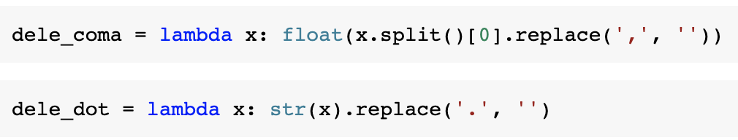
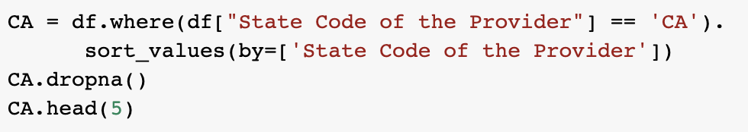
Data Cleaning

Slide 7
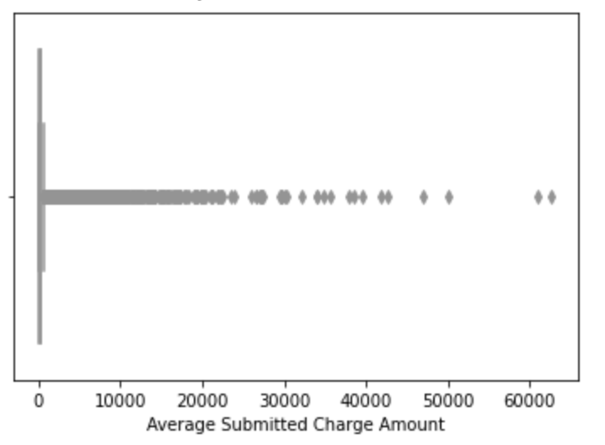
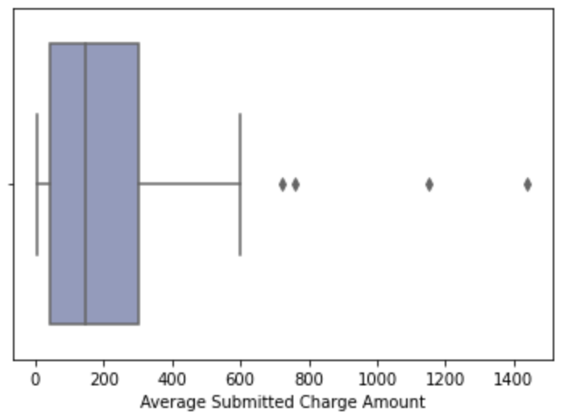
General Understanding
Boxplot
Notes:
The above graph is the visualization of all the average submitted charge amount.
The right one is when we randomly selected 50 producers' charge amount data. The box was much clearer.

Slide 8
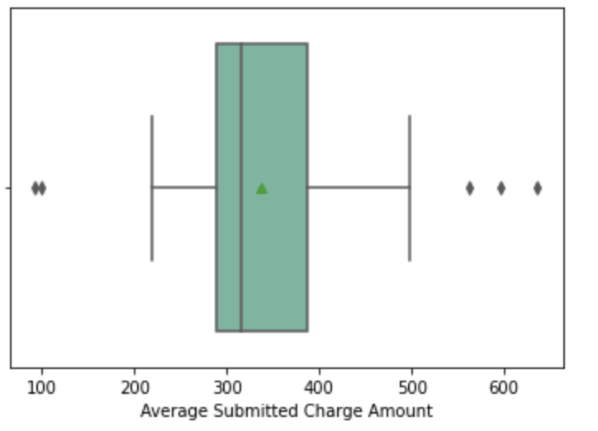
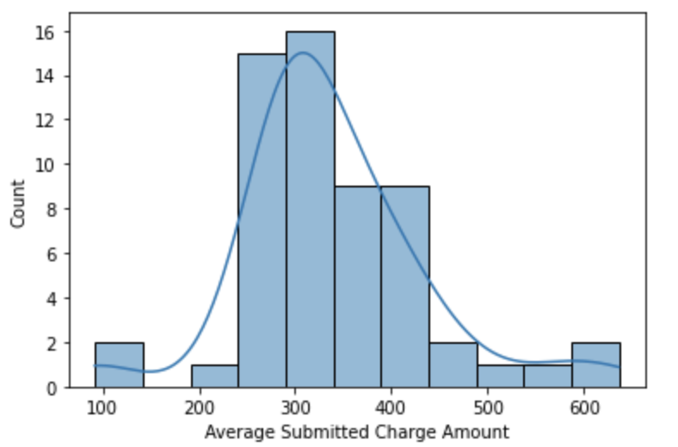
Categorized by State
Mean
Outliers
Distribution
right-skewed

Slide 9
2
Experiment
Model Building

Slide 10
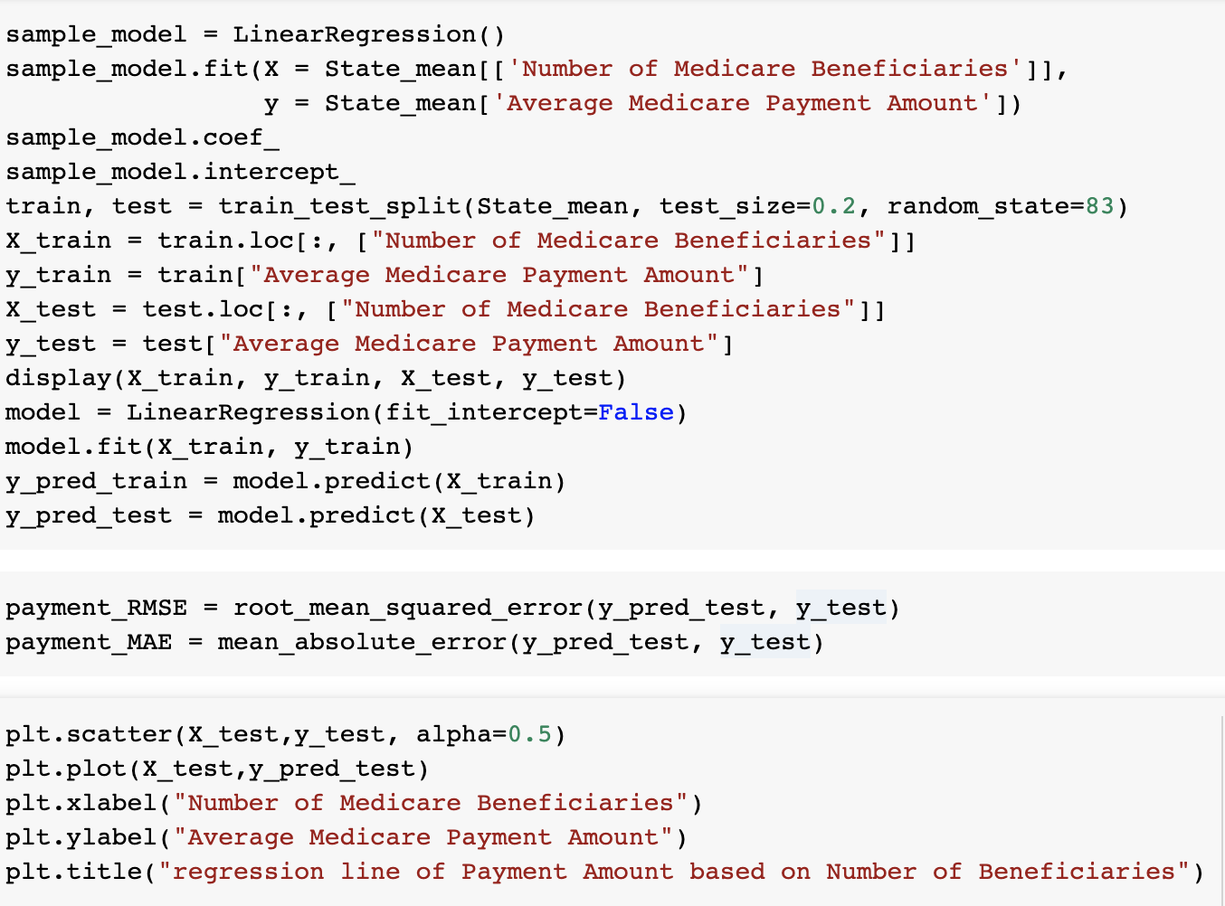
Linear Regression
Selected payment amount as response variable.
First groupby data based on States
Saturn is composed of hydrogen and helium

Slide 11
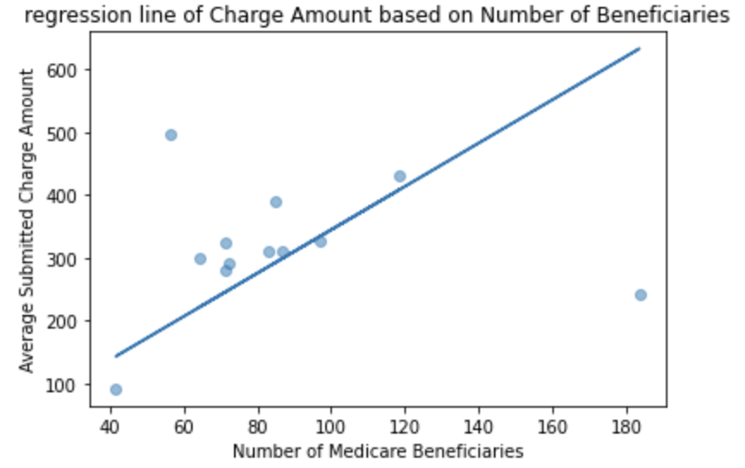
Charge Amount
& Beneficiaries
We can see that the regression line fits with the data mostly. There is a pretty obvious outlier value at the right of this graph, with about 180 at the number of medicare beneficiaries while 60 as the payment amount,which is way much lower than predicted value based on the regression relationship.
RMSE: 26.99, MAE: 18.93
Notes:
This is the graph that combines regression model and scatterplot. The x-value is the number of medicare beneficiaries and y-value is the average medicare payment amount of the medical service producers.
The RMSE of this regression prediction is 26.995905543053972 and MAE is 18.927994027986994. We can see that the regression line fits with the data mostly.
There is a pretty obvious outlier value at the right of this graph, with about 180 at the number of medicare beneficiaries while 60 as the payment amount,which is way much lower than predicted value based on the regression relationship.

Slide 12
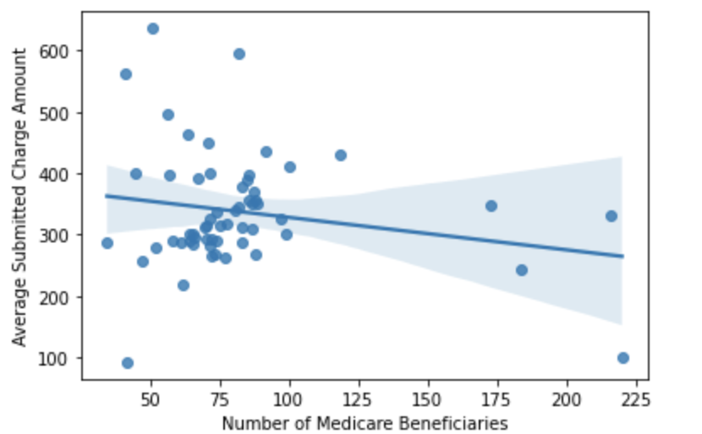
Charge Amount
& Beneficiaries
“
sns.regplot(State_mean["Number of Medicare Beneficiaries"], State_mean["Average Submitted Charge Amount"])
“
The graph is a scatterplot with regression line and confidence interval lines

Slide 13
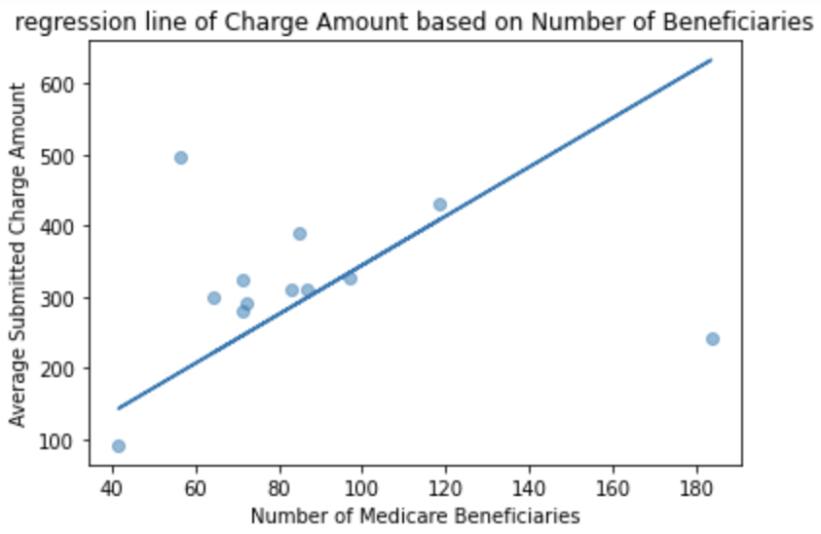
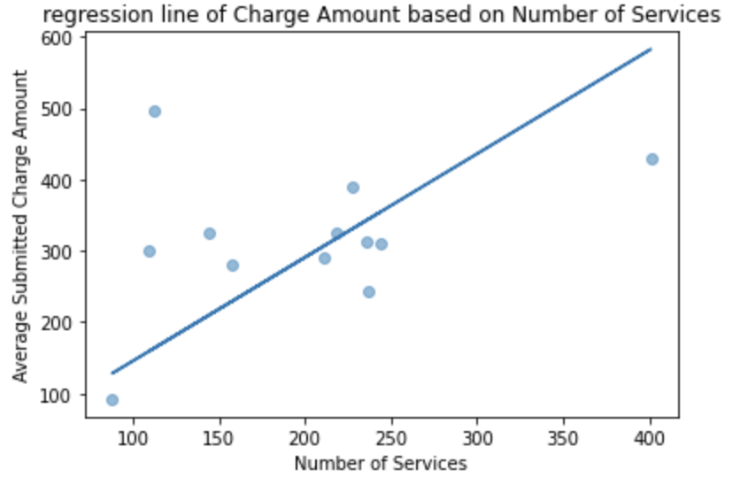
Compare input variable
It seems like Number of Beneficiaries can be a better indicator of outliers.
Notes:
Through comparing Linear Regression - Payment Amount & Number of Services and Linear Regression - Payment Amount & Number of Beneficiaries, it seems like Number of Beneficiaries can be a better indicator of outliers.
BUT the data still can not show the whole picture (eg: only shows the situation in America) so there may be other interfering factors.

Slide 14
3
Exploration
Other Factors

Slide 15
DO
MD
= Doctor of Osteopathic
Medicine
= Doctor of Medicine
Comprehensive Medical Licensing Examination
practice as primary care physicians and work in rural areas (more on this later)
200 hours of training in osteopathic manipulative treatment
37 accredited DO programs
More nontraditional backgrounds
United States Medical Licensing Exam (USMLE)
specialize (e.g., cardiology, neurology, ophthalmology) and work in urban areas
Typical medical curriculum
155 accredited MD programs
Notes:
There is a roughly 9:1 ratio of MD vs. DO physicians in the United States.
Medical students in DO programs must complete 200 hours of training in osteopathic manipulative treatment (OMT; physically manipulating body tissue to treat patients) beyond the typical medical curriculum. MD students do not receive OMT training during medical school.

Slide 16
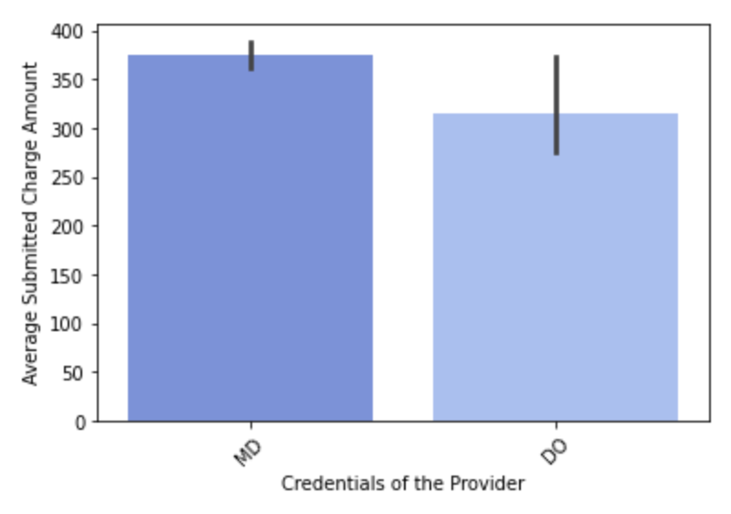
Bar Plot
MD and DO are categorical data
-- barplot
Providers with MD credential tend to set higher average submitted charge amount in healthcare products than those with DO credential.

Slide 17
More Information?
Colab link
https://colab.research.google.com/drive/1TJ0SJLHkKm51gAcGLPmiiYKqBswQPrw2?usp=sharing

Slide 18
THANKS

